Slide 1

Get Paid

Slide 2
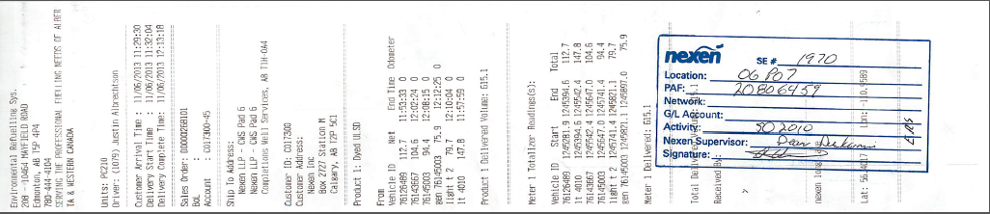
Sales Order
D268101.pdf

Slide 3
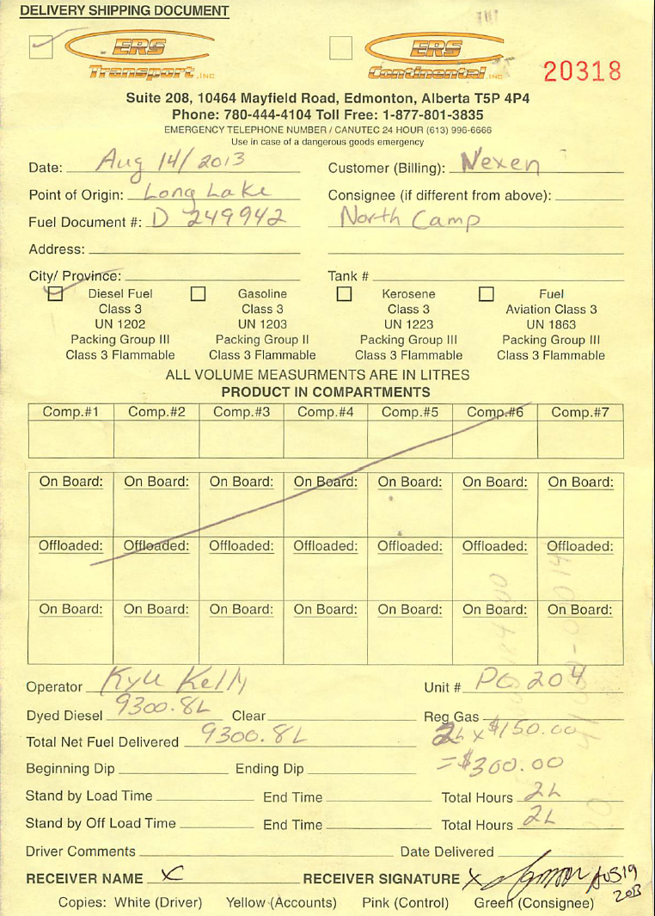
DSD

Slide 4
Complex requirements
Company | Delivery ticket | DT signed | Truck and man ticket | Work Order | Daily Summary
A – site 1 | x |  | x
- site 2 |  | x |  | x | x
B | x
C |  |  | x |  | x
D |  | x | x | x
And then there’s the coding ….

Slide 5
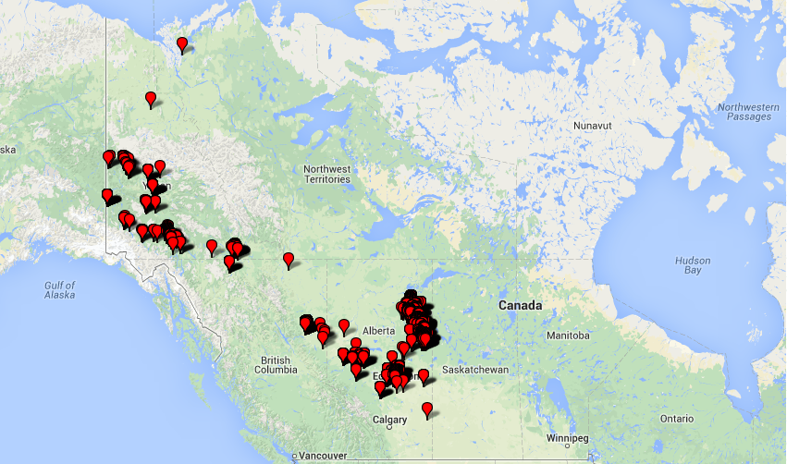
Deliveries in 2013
Remote communities
Yukon Gold
Oilsands
Shale Gas
Edmonton City

Slide 6

Onsite challenges
Smart Truck
Finance
Invoice to customer
DSD
SO
DSD
check ‘n chase
Email, photo,superB
days, weeks, months

Slide 7

New System
Smart Truck
NAV
Invoice to Nexen
SO
DSD
Classifier
check ‘n chase
Completeness and Matching
Repository
Customer rules

